Slide 1
Hovercraft VDP 2
Group 13
Paul Longe
Bradley
Keqi
Divine
Xiang
Alex

Slide 2
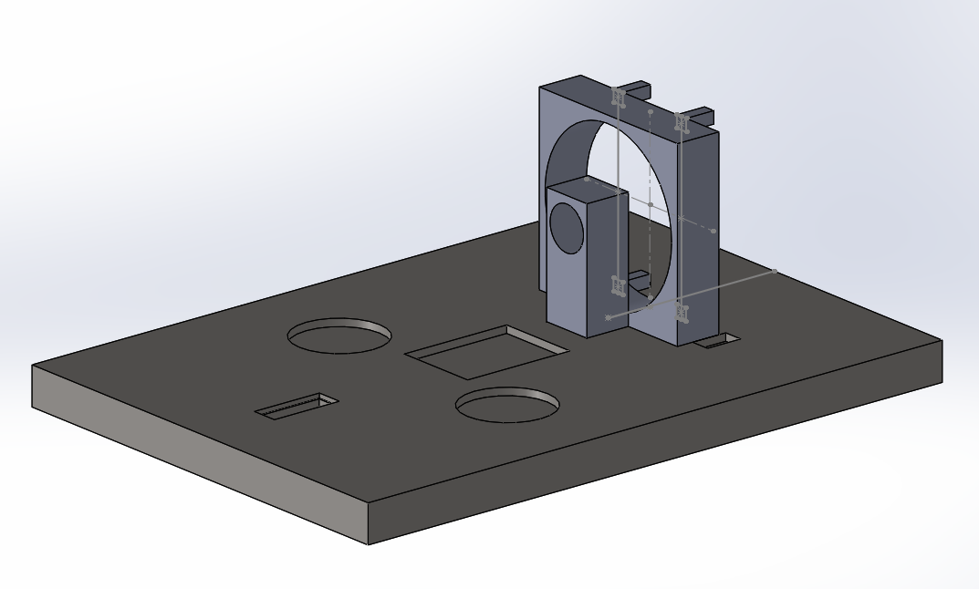
Payload – Final Design
XIANG ZHANG- Payload Engineer
The load areas are placed symmetrically about the center line of the hovercraft.
Grooves are provided for the lift fan, load, servo, motor holder and battery to be fixed to them.
All of the extruded cut should be larger than the actual components to fix them.
Servo is on one side of the propulsion fan.
Four support sticks will be placed behind the propulsion fan to fix the rudders.
Propulsion fan case
Support stick
Battery area
motor holder
Load area
servo area
Lift fan area
CALCULATIONS
All of the apparatus are vertically symmetrical about the centre line except for the servo.
Horizontally symmetric---left hand side moment=right hand side moment
(150+11+51)*(87.5+15)=33*102.5+200*x+200*x(x=position of the load)
X=46mm
The load area should be placed 23mm away from the centre point to balance the hovercraft.
Name | Length x width x thickness/mm | Weight/g
Payload area | 415 x 292 x 25 | 340(without load)
Battery | 74 x 55 x 20 | 145
Lift | 75 x 75 x 15.4 | 33
Propulsion | 100 x 100 x 25 | 150
servo | 23 x 12 x 27 | 11
Load | 57 x 57 x 11.5 | 200
motor | 27.7 x 27.7 x 47 | 51

Slide 3
